Slide 1



DEPARTMENT OF COMPUTER SCIENCE
&
ENGINEERING
Course Name: Operation System (BCON008B )

Slide 2
BC0 008B
Operating Systems
Unit-I

Slide 3
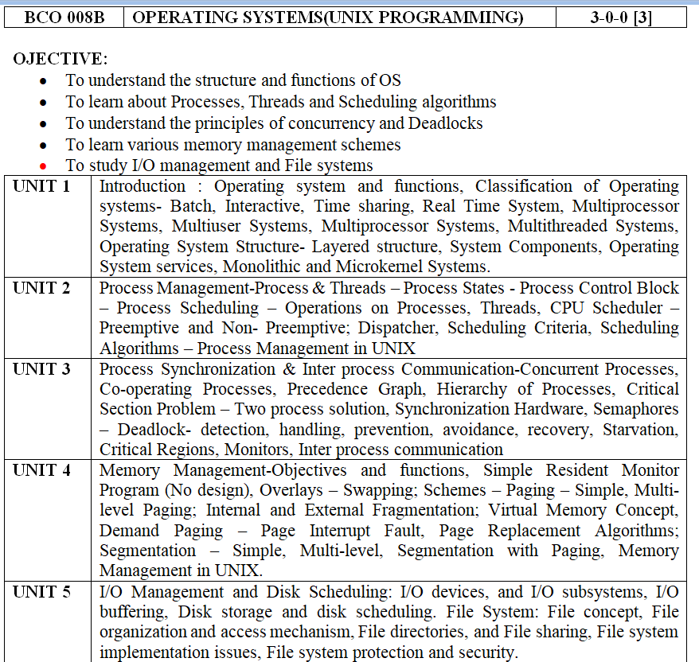

Slide 4
Text Books:
1. Operating Systems Concepts – Silberschatz, Galvin, Wiley Publications (2008)
2. Modern Operating Systems - Andrew S. Tanenbaum, Pearson Education Asia / PHI(2005)
Reference Books:
Operating Systems – William Stallings, Pearson Education Asia (2002)
UNIX System Programming Using C++, by Terrence Chan: Prentice Hall India, 1999.
Advanced Programming in UNIX Environment, by W. Richard Stevens: 2nd Ed, Pearson Education, 2005

Slide 5
Course Outcome (CO):
At the ends of this course studentswill have:
CO1: Classify Unix Kernel mode with user mode & contrast between Kernel structures.
CO2: Identify and estimate process management & thread management strategies along with their different operations
CO3: Implement deadlock and different system calls for various file handling operations.
CO4: Determine Paging and Caching techniques related to Virtual Memory.

Slide 6
Mapping of COs with Pos
MAPPING COURSE OUTCOMES LEADING TO THE ACHIEVEMENT OF
PROGRAM OUTCOMES AND PROGRAM SPECIFIC OUTCOMES:
Course Outcome | Program Outcome |  |  |  |  |  |  |  |  |  |  |  | Program Specifice Outcome
 | PO1 | PO2 | PO3 | PO4 | PO5 | PO6 | PO7 | PO8 | PO9 | PO10 | PO11 | PO12 | PSO1 | PSO2 | PSO3
CO1 | H |  |  | M |  |  |  | L |  |  | L |  | H |  | L
CO2 |  | M | L |  |  |  |  |  | M |  |  |  |  | M
CO3 |  |  | M |  | M |  |  |  |  |  |  |  |  | M | M
CO4 | M |  | L |  |  |  |  |  |  |  |  | L
H = Highly Related; M = Medium L = Low

Slide 7
Introduction to Process Management
An operating system executes a variety of programs:
  Batch system – jobs
  Time-shared systems – user programs or tasks
Textbook uses the terms job and process almost interchangeably
Process – a program in execution; process execution must progress in sequential fashion
Multiple parts
  The program code, also called text section
  Current activity including program counter, processor registers
  Stack containing temporary data
    Function parameters, return addresses, local variables
  Data section containing global variables
  Heap containing memory dynamically allocated during run time

Slide 8
Process Management Cont..
Program is passive entity stored on disk (executable file), process is active
Program becomes process when executable file loaded into memory
Execution of program started via GUI mouse clicks, command line entry of its name, etc
One program can be several processes
Consider multiple users executing the same program

Slide 9
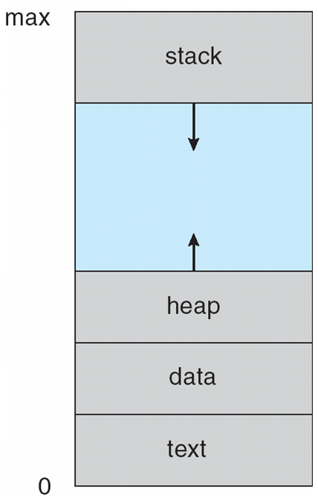
Process in Memory

Slide 10
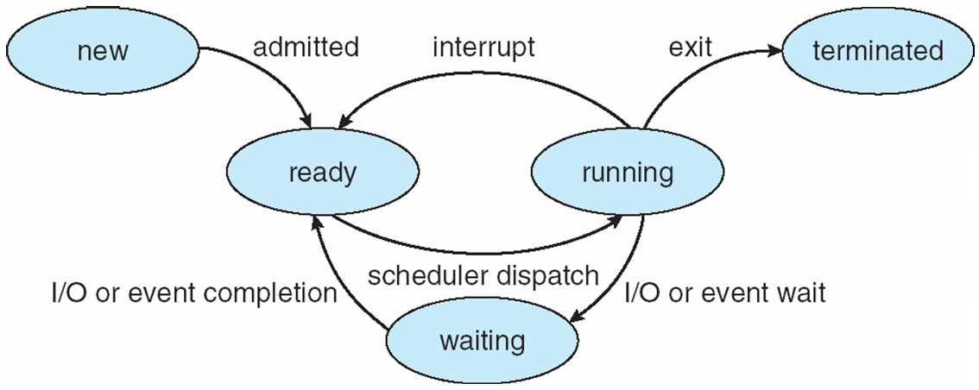
Diagram of Process State

Slide 11
Process Scheduling
Maximize CPU use, quickly switch processes onto CPU for time sharing
Process scheduler selects among available processes for next execution on CPU
Maintains scheduling queues of processes
  Job queue – set of all processes in the system
  Ready queue – set of all processes residing in main memory, ready and waiting to execute
  Device queues – set of processes waiting for an I/O device
  Processes migrate among the various queues

Slide 12
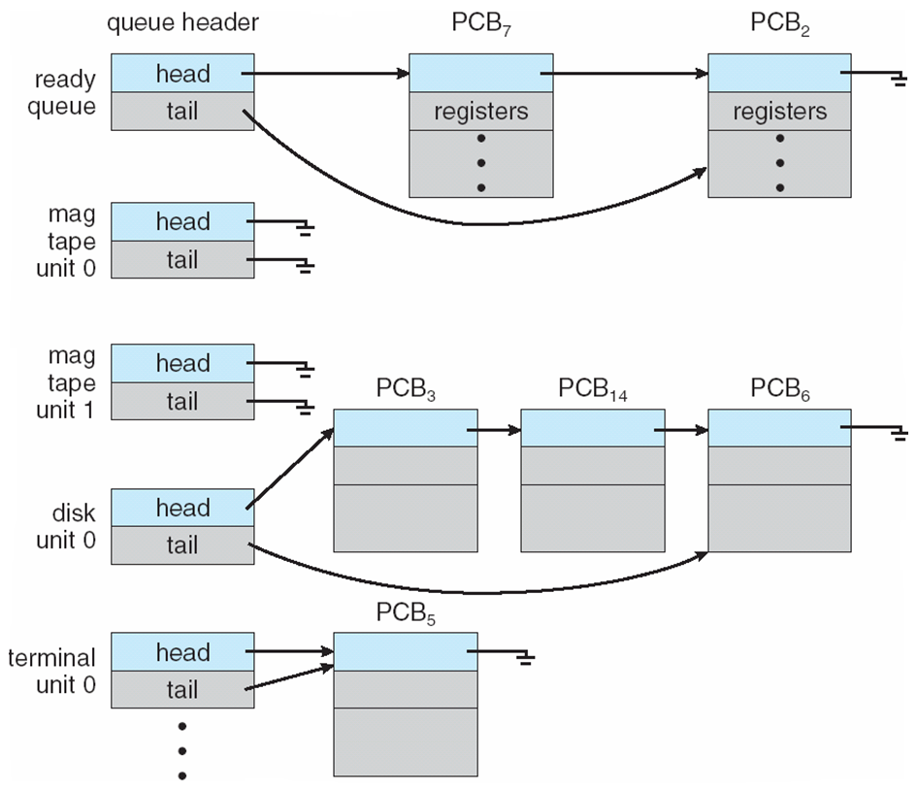
Ready Queue And Various I/O Device Queues

Slide 13
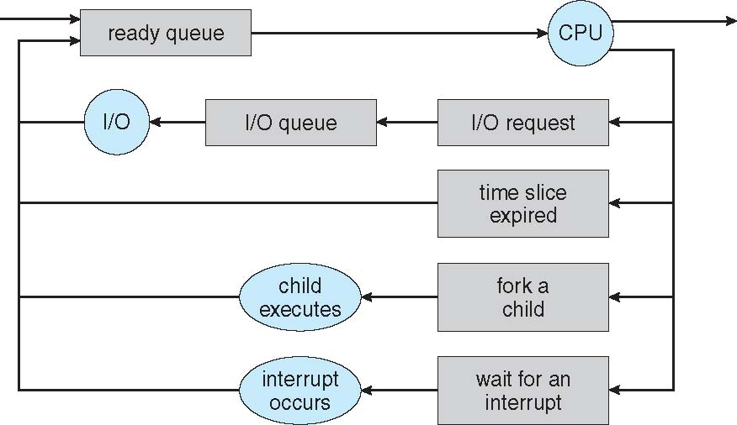
Representation of Process Scheduling
Queueing diagram represents queues, resources, flows

Slide 14
Process State
As a process executes, it changes state
  new: The process is being created
  running: Instructions are being executed
  waiting: The process is waiting for some event to occur
  ready: The process is waiting to be assigned to a processor
  terminated: The process has finished execution

Slide 15
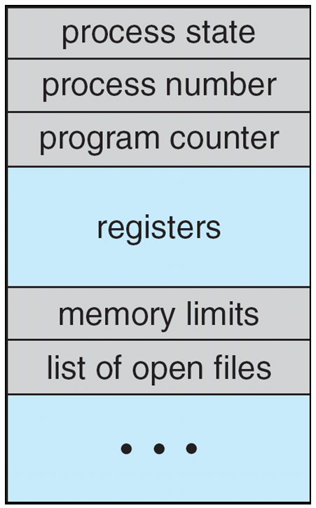
Process Control Block (PCB)
Information associated with each process (also called task control block)
Process state – running, waiting, etc
Program counter – location of instruction to next execute
CPU registers – contents of all process-centric registers
CPU scheduling information- priorities, scheduling queue pointers
Memory-management information – memory allocated to the process
Accounting information – CPU used, clock time elapsed since start, time limits
I/O status information – I/O devices allocated to process, list of open files

Slide 16
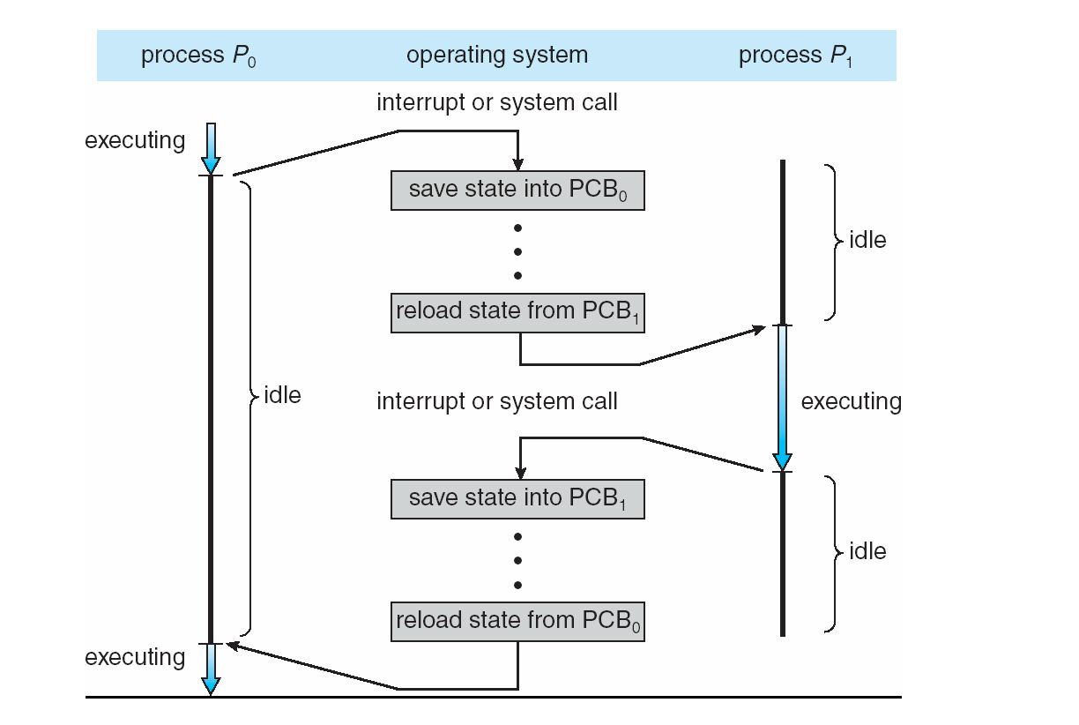
CPU Switch From Process to Process

Slide 17
Operations on Processes
System must provide mechanisms for:
  process creation,
  process termination,
  and so on as detailed next

Slide 18
Process Creation
Parent process create children processes, which, in turn create other processes, forming a tree of processes
Generally, process identified and managed via a process identifier (pid)
Resource sharing options
  Parent and children share all resources
  Children share subset of parent’s resources
  Parent and child share no resources
Execution options
  Parent and children execute concurrently
  Parent waits until children terminate

Slide 19
Threads
So far, process has a single thread of execution
Consider having multiple program counters per process
  Multiple locations can execute at once
    Multiple threads of control -> threads
Must then have storage for thread details, multiple program counters in PCB
See next chapter

Slide 20
CPU Scheduler
Short-term scheduler selects from among the processes in ready queue, and allocates the CPU to one of them
  Queue may be ordered in various ways
CPU scheduling decisions may take place when a process:
  1. Switches from running to waiting state
  2. Switches from running to ready state
  3. Switches from waiting to ready
  Terminates

Slide 21
CPU Scheduler. Cont…..
Scheduling under 1 and 4 is nonpreemptive
All other scheduling is preemptive
  Consider access to shared data
  Consider preemption while in kernel mode
  Consider interrupts occurring during crucial OS activities

Slide 22
Preemptive CPU Scheduling
Definition:
Preemptive CPU scheduling is a scheduling technique in which the Operating System can take the CPU away from a running process and assign it to another process.
When can preemption occur?
A new process with higher priority arrives.
A process with a shorter remaining time becomes ready.
The time quantum expires in Round Robin scheduling.

Slide 23
Preemptive CPU Scheduling
An interrupt occurs.
Key Point:
The running process can be interrupted before completion.

Slide 24
Preemptive CPU Scheduling Cont….
Example of Pre-emptive Scheduling
Consider: Suppose a scheduling algorithm gives preference to P2 when it arrives.
Process | Arrival Time | Burst Time
P1 | 0 | 8
P2 | 2 | 3
Time → 0 2 5 11
|----|-------|-----------|
P1 P2 P1

Slide 25
Preemptive CPU Scheduling Cont….
P1 starts at time 0.
P2 arrives at time 2.
P1 is preempted.
P2 executes from 2 to 5.
P1 resumes from 5 to 11.
P1 does not need to finish before P2 gets the CPU.

Slide 26
Non-Preemptive CPU Scheduling
Definition:
Non-preemptive CPU scheduling is a technique in which once a process gets the CPU, the OS does not forcibly take the CPU away from it.
The process continues until:
It terminates, or
It changes to the waiting/blocked state.
Key Point:
The running process keeps the CPU until it voluntarily releases it.

Slide 27
Example of Non-Preemptive CPU Scheduling
P1 starts at time 0.
P2 arrives at time 2.
P1 continues running.
P1 finishes at time 8.
P2 gets the CPU from 8 to 11.
Process | Arrival Time | Burst Time
P1 | 0 | 8
P2 | 2 | 3
Time → 0 8 11
|-----------------|--------|
P1 P2

Slide 28
Context Switching
Definition:
Context switching is the process of switching the CPU from one process to another by saving the state of the current process and loading the state of the next process.
How Context Switching Works
Step 1: Current process is running
Step 2: OS saves its current state in the PCB
Step 3: OS selects another process
Step 4: OS loads the saved state of the new process
Step 5: New process starts/resumes execution

Slide 29
What is Saved?
Program Counter (PC)
CPU Registers
Stack Pointer
Process State
Other process-related information

Slide 30
Context Switiching Cont…
Example
Suppose P1 is running and the CPU needs to execute P2.
P1 Running → Context Switch → P2 Running
Later:
P2 Running → Context Switch → P1 Running
The saved information of each process is maintained in its Process Control Block (PCB).

Slide 31
Context Switiching Cont…
Key Point
Context Switching = Save the current process + Load the next process
Note: Context switching allows the CPU to efficiently switch between multiple processes, but it also introduces overhead because saving and loading process states takes CPU time.

Slide 32
Dispatcher
Dispatcher module gives control of the CPU to the process selected by the short-term scheduler; this involves:
  switching context
  switching to user mode
  jumping to the proper location in the user program to restart that program
Dispatch latency – time it takes for the dispatcher to stop one process and start another running

Slide 33
Scheduling Criteria
CPU utilization – keep the CPU as busy as possible
Throughput – # of processes that complete their execution per time unit
Turnaround time – amount of time to execute a particular process
Waiting time – amount of time a process has been waiting in the ready queue
Response time – amount of time it takes from when a request was submitted until the first response is produced, not output (for time-sharing environment)

Slide 34
Process Scheduling
Maximize CPU use, quickly switch processes onto CPU for time sharing
Process scheduler selects among available processes for next execution on CPU
Maintains scheduling queues of processes
  Job queue – set of all processes in the system
  Ready queue – set of all processes residing in main memory, ready and waiting to execute
  Device queues – set of processes waiting for an I/O device
  Processes migrate among the various queues

Slide 35
Scheduling Algorithms
First- Come, First-Served (FCFS) Scheduling
Process. Burst Time
P₁ 24
P₂ 3
P₃ 3
Suppose that the processes arrive in the order: P₁ , P₂ , P₃
The Gantt Chart for the schedule is:
Waiting time for P₁ = 0; P₂ = 24; P₃ = 27
Average waiting time: (0 + 24 + 27)/3 = 17

Slide 36
FCFS Scheduling (Cont.)
Suppose that the processes arrive in the order:
P₂ , P₃ , P₁
The Gantt chart for the schedule is:
Waiting time for P₁ = 6; P₂ = 0; P₃ = 3
Average waiting time: (6 + 0 + 3)/3 = 3
Much better than previous case
Convoy effect - short process behind long process
  Consider one CPU-bound and many I/O-bound processes

Slide 37
Shortest-Job-First (SJF) Scheduling
Associate with each process the length of its next CPU burst
  Use these lengths to schedule the process with the shortest time
SJF is optimal – gives minimum average waiting time for a given set of processes
  The difficulty is knowing the length of the next CPU request
  Could ask the user

Slide 38
Example of SJF
Process. Burst Time
P₁ 6
P₂ 8
P₃ 7
P₄ 3
SJF scheduling chart
Average waiting time = (3 + 16 + 9 + 0) / 4 = 7

Slide 39
Example of Shortest-remaining-time-first
Now we add the concepts of varying arrival times and preemption to the analysis
ProcessA arri Arrival TimeT Burst Time
P₁ 0 8
P₂ 1 4
P₃ 2 9
P₄ 3 5
Preemptive SJF Gantt Chart
Average waiting time = [(10-1)+(1-1)+(17-2)+5-3)]/4 = 26/4 = 6.5 msec

Slide 40
Priority Scheduling
A priority number (integer) is associated with each process
The CPU is allocated to the process with the highest priority (smallest integer ≡ highest priority)
  Preemptive
  Non-preemptive
SJF is priority scheduling where priority is the inverse of predicted next CPU burst time
Problem ≡ Starvation – low-priority processes may never execute
Solution ≡ Aging – as time progresses increase the priority of the process

Slide 41
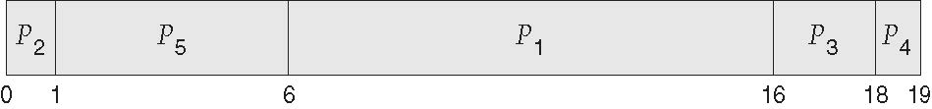
Example of Priority Scheduling
Process. Burst Time. Priority
P₁ 10 3
P₂ 1 1
P₃ 2 4
P₄ 1 5
P₅ 5 2
Priority scheduling Gantt Chart
Average waiting time = 8.2 msec

Slide 42
Round Robin (RR)
Each process gets a small unit of CPU time (time quantum q), usually 10-100 milliseconds. After this time has elapsed, the process is preempted and added to the end of the ready queue.
If there are n processes in the ready queue and the time quantum is q, then each process gets 1/n of the CPU time in chunks of at most q time units at once. No process waits more than (n-1)q time units.
Timer interrupts every quantum to schedule next process
Performance
  q large ⇒ FIFO
  q small ⇒ q must be large with respect to context switch, otherwise overhead is too high

Slide 43
Example of RR with Time Quantum = 4
Process Burst Time
P₁ 24
P₂ 3
P₃ 3
The Gantt chart is:
Typically, higher average turnaround than SJF, but better response
q should be large compared to context switch time
q usually 10ms to 100ms, context switch < 10 usec

Slide 44
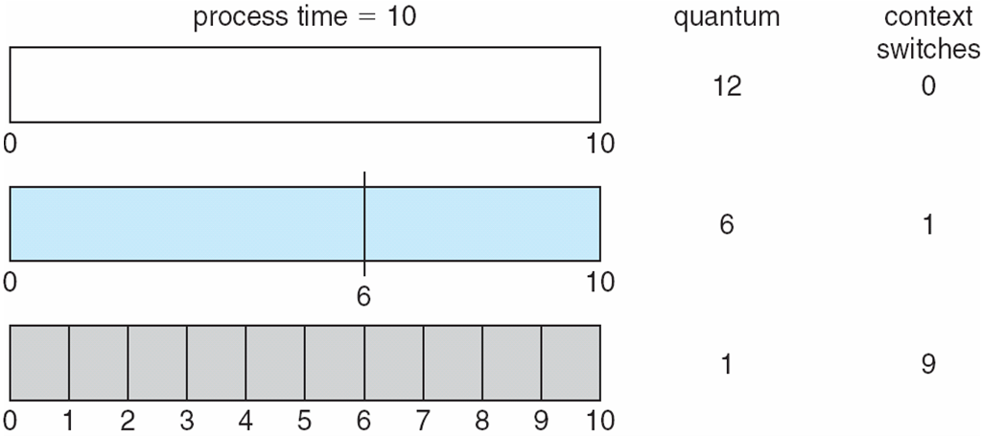
Time Quantum and Context Switch Time

Slide 45
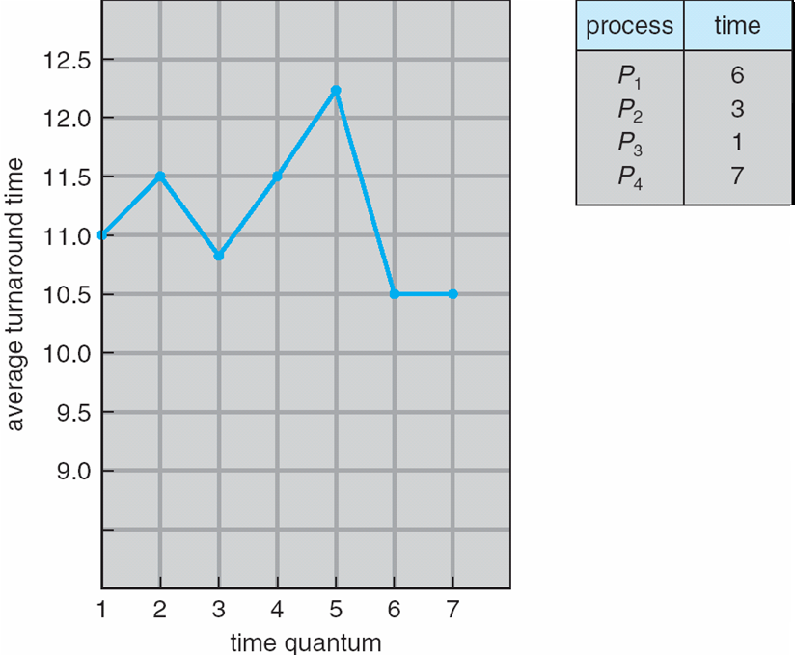
Turnaround Time Varies With The Time Quantum
80% of CPU bursts should be shorter than q

Slide 46
A Tree of Processes in Linux

Slide 47
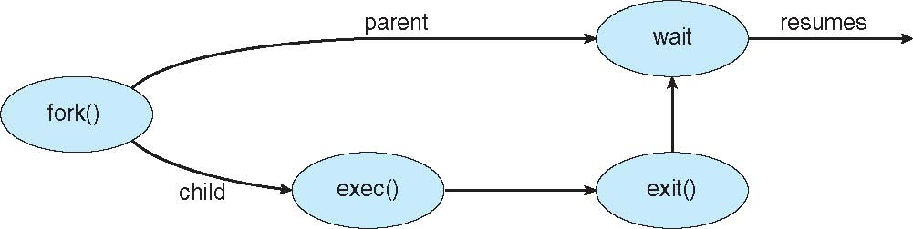
Process Creation (Cont.)
Address space
  Child duplicate of parent
  Child has a program loaded into it
UNIX examples
  fork() system call creates new process
  exec() system call used after a fork() to replace the process’ memory space with a new program

Slide 48
Process Termination
Process executes last statement and then asks the operating system to delete it using the exit() system call.
  Returns status data from child to parent (via wait())
  Process’ resources are deallocated by operating system
Parent may terminate the execution of children processes using the abort() system call. Some reasons for doing so:
  Child has exceeded allocated resources
  Task assigned to child is no longer required
  The parent is exiting and the operating systems does not allow a child to continue if its parent terminates

Slide 49
Process Termination
Some operating systems do not allow child to exists if its parent has terminated. If a process terminates, then all its children must also be terminated.
  cascading termination. All children, grandchildren, etc. are terminated.
  The termination is initiated by the operating system.
The parent process may wait for termination of a child process by using the wait()system call. The call returns status information and the pid of the terminated process
pid = wait(&status);
If no parent waiting (did not invoke wait()) process is a zombie
If parent terminated without invoking wait , process is an orphan

Slide 50
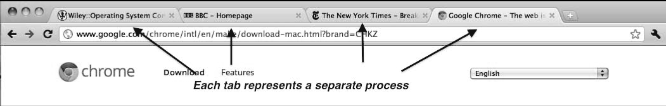
Multiprocess Architecture – Chrome Browser
Many web browsers ran as single process (some still do)
  If one web site causes trouble, entire browser can hang or crash
Google Chrome Browser is multiprocess with 3 different types of processes:
  Browser process manages user interface, disk and network I/O
  Renderer process renders web pages, deals with HTML, Javascript. A new renderer created for each website opened
    Runs in sandbox restricting disk and network I/O, minimizing effect of security exploits
  Plug-in process for each type of plug-in

Slide 51
Interprocess Communication
Processes within a system may be independent or cooperating
Cooperating process can affect or be affected by other processes, including sharing data
Reasons for cooperating processes:
  Information sharing
  Computation speedup
  Modularity
  Convenience
Cooperating processes need interprocess communication (IPC)
Two models of IPC
  Shared memory
  Message passing

Slide 52
Communications Models
(a) Message passing. (b) shared memory.

Slide 53
Cooperating Processes
Independent process cannot affect or be affected by the execution of another process
Cooperating process can affect or be affected by the execution of another process
Advantages of process cooperation
  Information sharing
  Computation speed-up
  Modularity
  Convenience

Slide 54
Producer-Consumer Problem
Paradigm for cooperating processes, producer process produces information that is consumed by a consumer process
  unbounded-buffer places no practical limit on the size of the buffer
  bounded-buffer assumes that there is a fixed buffer size

Slide 55
Bounded-Buffer – Shared-Memory Solution
Shared data
      #define BUFFER_SIZE 10
      typedef struct {
      . . .
      } item;
      item buffer[BUFFER_SIZE];
      int in = 0;
      int out = 0;
Solution is correct, but can only use BUFFER_SIZE-1 elements

Slide 56
Bounded-Buffer – Producer
item next_produced;
while (true) {
/* produce an item in next produced */
while (((in + 1) % BUFFER_SIZE) == out)
; /* do nothing */
buffer[in] = next_produced;
in = (in + 1) % BUFFER_SIZE;
}

Slide 57
Bounded Buffer – Consumer
item next_consumed;
while (true) {
while (in == out)
; /* do nothing */
next_consumed = buffer[out];
out = (out + 1) % BUFFER_SIZE;
/* consume the item in next consumed */
}

Slide 58
Interprocess Communication – Shared Memory
An area of memory shared among the processes that wish to communicate
The communication is under the control of the users processes not the operating system.
Major issues is to provide mechanism that will allow the user processes to synchronize their actions when they access shared memory.
Synchronization is discussed in great details in Chapter 5.

Slide 59
Interprocess Communication – Message Passing
Mechanism for processes to communicate and to synchronize their actions
Message system – processes communicate with each other without resorting to shared variables
IPC facility provides two operations:
  send(message)
  receive(message)
The message size is either fixed or variable

Slide 60
Message Passing (Cont.)
If processes P and Q wish to communicate, they need to:
  Establish a communication link between them
  Exchange messages via send/receive
Implementation issues:
  How are links established?
  Can a link be associated with more than two processes?
  How many links can there be between every pair of communicating processes?
  What is the capacity of a link?
  Is the size of a message that the link can accommodate fixed or variable?
  Is a link unidirectional or bi-directional?

Slide 61
Message Passing (Cont.)
Implementation of communication link
  Physical:
    Shared memory
    Hardware bus
    Network
  Logical:
    Direct or indirect
    Synchronous or asynchronous
    Automatic or explicit buffering

Slide 62
Direct Communication
Processes must name each other explicitly:
  send (P, message) – send a message to process P
  receive(Q, message) – receive a message from process Q
Properties of communication link
  Links are established automatically
  A link is associated with exactly one pair of communicating processes
  Between each pair there exists exactly one link
  The link may be unidirectional, but is usually bi-directional

Slide 63
Indirect Communication
Messages are directed and received from mailboxes (also referred to as ports)
  Each mailbox has a unique id
  Processes can communicate only if they share a mailbox
Properties of communication link
  Link established only if processes share a common mailbox
  A link may be associated with many processes
  Each pair of processes may share several communication links
  Link may be unidirectional or bi-directional

Slide 64
Indirect Communication
Operations
  create a new mailbox (port)
  send and receive messages through mailbox
  destroy a mailbox
Primitives are defined as:
send(A, message) – send a message to mailbox A
receive(A, message) – receive a message from mailbox A

Slide 65
Indirect Communication
Mailbox sharing
  P₁, P₂, and P₃ share mailbox A
  P₁, sends; P₂ and P₃ receive
  Who gets the message?
Solutions
  Allow a link to be associated with at most two processes
  Allow only one process at a time to execute a receive operation
  Allow the system to select arbitrarily the receiver. Sender is notified who the receiver was.

Slide 66
Synchronization
Message passing may be either blocking or non-blocking
Blocking is considered synchronous
  Blocking send -- the sender is blocked until the message is received
  Blocking receive -- the receiver is blocked until a message is available
Non-blocking is considered asynchronous
  Non-blocking send -- the sender sends the message and continue
  Non-blocking receive -- the receiver receives:
    A valid message, or
    Null message
Different combinations possible
  If both send and receive are blocking, we have a rendezvous

Slide 67
Synchronization (Cont.)
Producer-consumer becomes trivial
message next_produced;
while (true) {
/* produce an item in next produced */
send(next_produced);
}
message next_consumed;
while (true) {
receive(next_consumed);
/* consume the item in next consumed */
}

Slide 68
Buffering
Queue of messages attached to the link.
implemented in one of three ways
  1. Zero capacity – no messages are queued on a link.
  Sender must wait for receiver (rendezvous)
  2. Bounded capacity – finite length of n messages
  Sender must wait if link full
  3. Unbounded capacity – infinite length
  Sender never waits

Slide 69

Thank You!!

